Slide 1
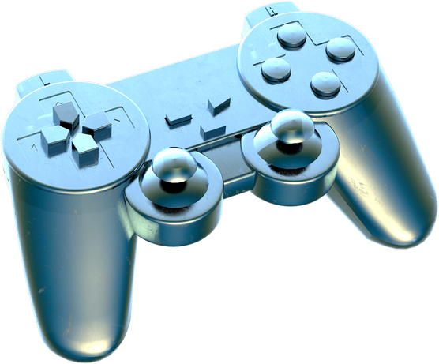

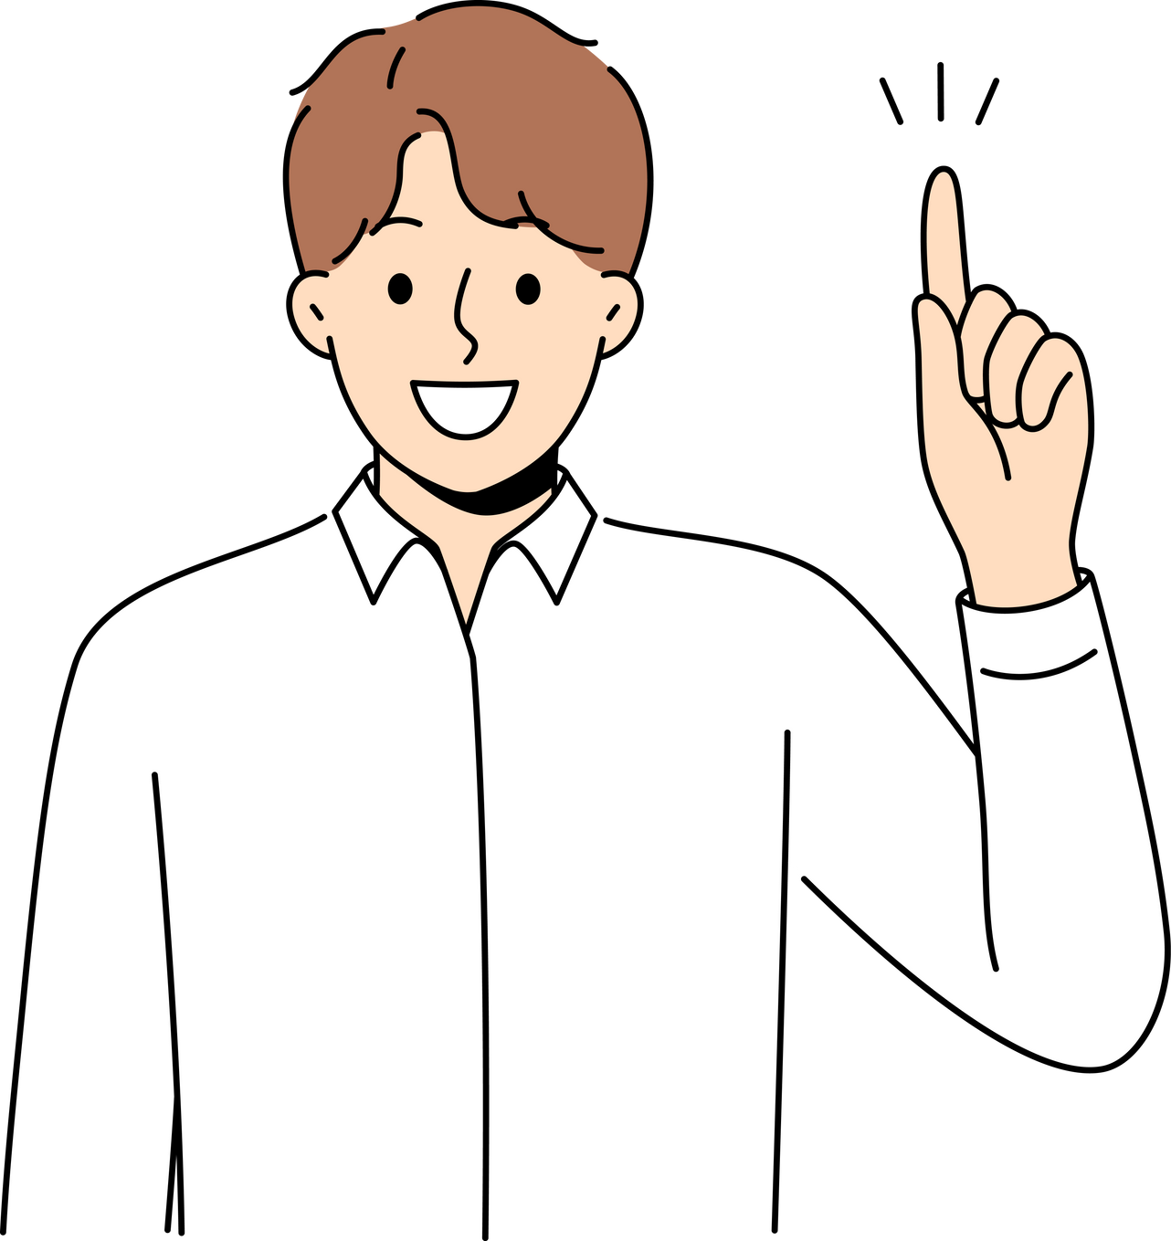
Virtual Painter using OpenCV and Mediapipe
Gesture-based Drawing Application

Slide 2
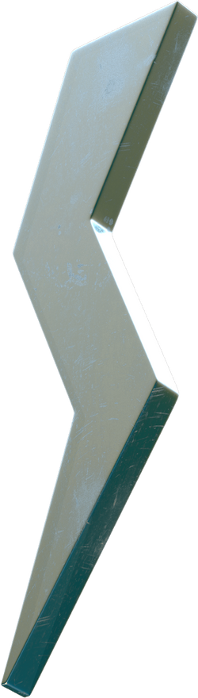
The Virtual Painter is an application that allows users to draw in the air using hand gestures.
Uses OpenCV and Mediapipe for hand tracking.
Detects finger movements to simulate a brush for digital drawing.
Introduction

Slide 3



Technologies Used
OpenCV – Image processing and real-time video capture.
Mediapipe – Hand tracking and landmark detection.
NumPy – Array operations and image handling.
Python – Programming language used for implementation.

Slide 4
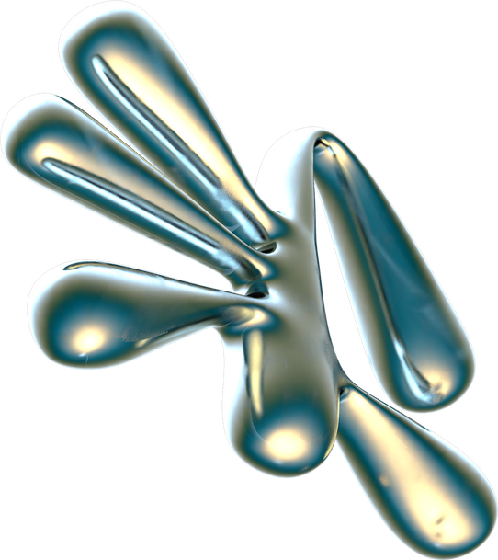
Features
Working Mechanism
Tracks index finger movement for drawing.
Color selection using on-screen buttons.
Clear screen functionality.
Uses deque to store and manage strokes.
Captures real-time video feed.
Uses Mediapipe to detect hand landmarks.
Tracks index finger movement for drawing.
Allows color selection via button interaction.
Stops drawing when the index finger and thumb are close together.

Slide 5

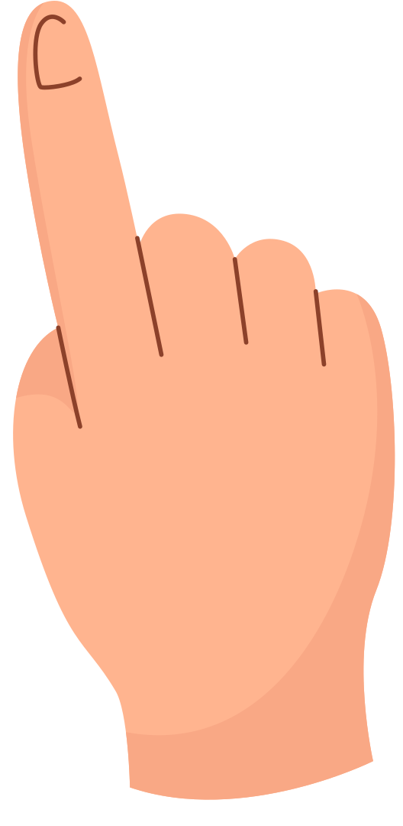
Code Flow
1. |  | 2. |  | 3. |  | 4. |  | 5.
Capture video from the webcam. |  | Detect hands using Mediapipe |  | Identify index finger and thumb positions. |  | Check if the finger is near color buttons. |  | Display real-time output.

Slide 6

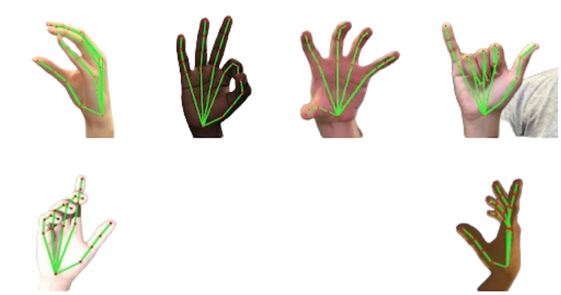
Demonstration
Include screenshots of the application in action.
Highlight different color selections and drawing examples.

Slide 7

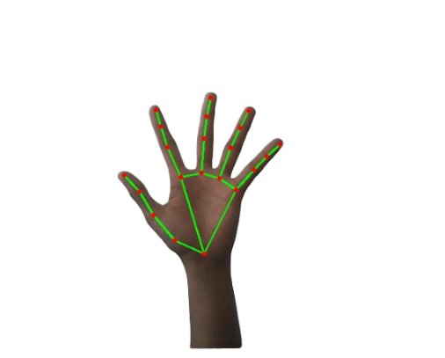
Future Enhancements
================================
Dynamic brush thickness based on hand gestures.
Eraser mode for better user experience.
Save drawings as images.
Advanced gesture controls (three-finger swipe to clear, etc.).

Slide 8
Conclusion
===============================
The Virtual Painter demonstrates real-time hand tracking and drawing using AI.
It provides an interactive and intuitive way to create digital art using hand gestures.
Future improvements can enhance usability and make it more versatile.

Slide 9
Thank
You

